Slide 1
ABOUT MOS
At present, individuals with an international MOS (Microsoft Office Specialist) certifications are getting attention from many domestic and foreign companies in employment recruiting, such as major financial institutes, and telecom corporations. Besides, MOS program is being used as a standard curriculum for K1-12 pupils and college students in our country. Since MOS is still new, therefore studying and obtaining the MOS certification is difficult due to some obstacles for the students.
Base on my own professional experiences and personal encounters, I will summarize several important topics to keep in mind when studying as well as taking exam for MOS certification.

Slide 2

MICROSOFT OFFICE SPECIALIST
Introduce by: Ly Tran Thai Hoc (M.Sc. I.T) Microsoft Certified Trainer – MOS Master – IC3 GS4 Authorized Educator Facebook: https://www.facebook.com/hocict.edu.vn YouTube: HOCICT Official Channel

Slide 3
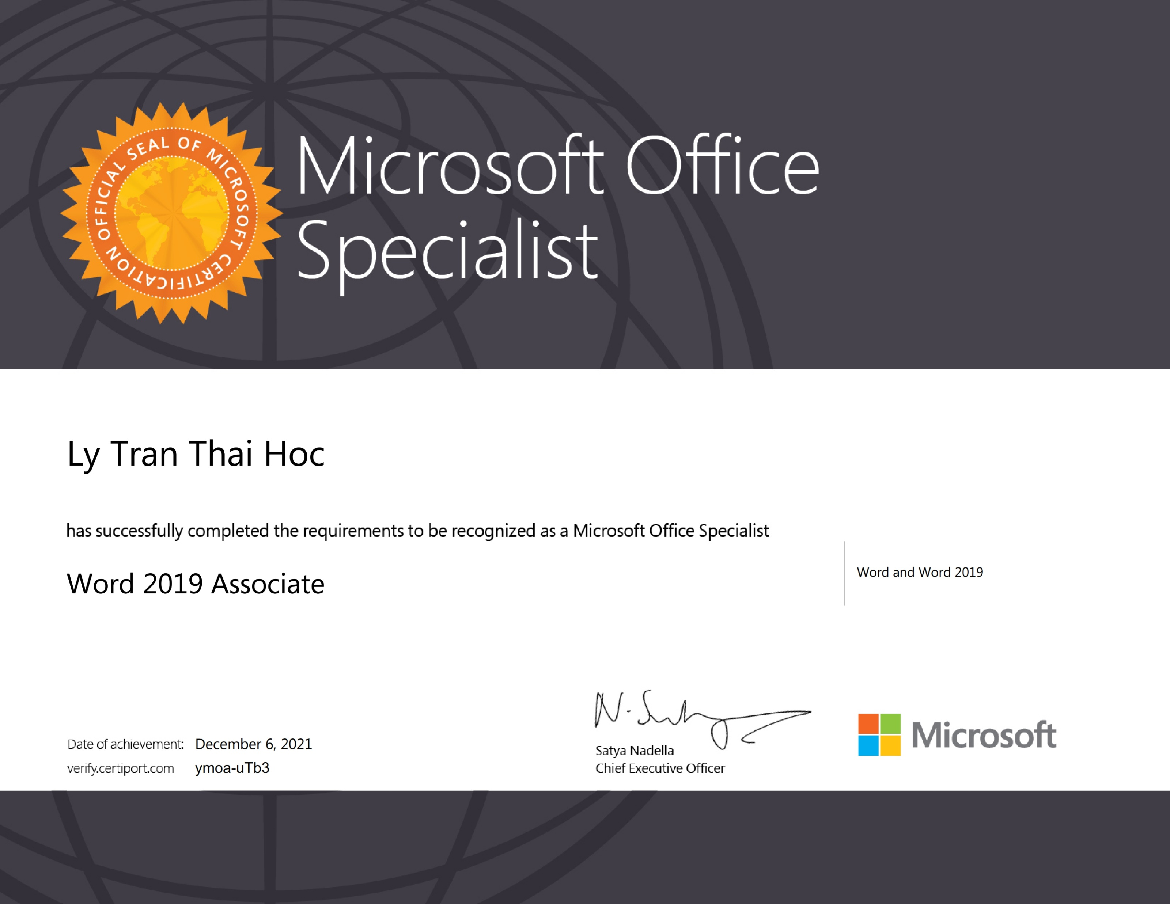
What is MOS Certification?
MOS is an abbreviation for Microsoft Office Specialist; it is a certification for advance proficiency skill of each application is Microsoft Office suite. This examination was create by Microsoft and implemented by Certiport (United States) worldwide.
MOS Certification is issued by the Microsoft Corporation itself and signed to endorse by the Microsoft’s Chief Executor Officer.

Slide 4
MOS LEVEL & MOS VERSION
Demonstrate that you have the skills needed to get the most out of Office by earning a Microsoft Office Specialist (MOS) certification in a specific Office program. Holding a MOS certification can earn an entry-level business employee as much as $16,000 more in annual salary than uncertified peers.*
Demonstrate that you have advanced skills in key Office programs by earning a Microsoft Office Specialist Expert certification.
Demonstrate that you have the deepest level of skills needed to proficiently use Microsoft Office.
Microsoft Office 2019
Microsoft Office 2016
Microsoft Office 2013
Microsoft Office 2010
Microsoft Office 2007
*Anderson, Cushing, and John F. Gantz. Skills Requirements for Tomorrow’s Best Jobs: Helping Educators Provide Students with Skills
and Tools They Need. IDC/Microsoft. October 2013. http://www.microsoft.com/en-us/news/download/presskits/education/docs/IDC_101513.pdf

Slide 5

Who issue MOS Certification?
MOS Certification is issued by the Microsoft Corporation itself and signed to endorse by the Microsoft’s Chief Executor Officer.
International Certificate

Slide 6
Student Benefits
Certifications help:
Differentiate yourself in today's competitive job market
Broaden your employment opportunities by displaying your advanced skills
Result in higher earning potential
Added plus on your resume
There is a global need for people highly skilled in Microsoft technologies, and Microsoft Certifications are the credentials you need to impress employers!
Some colleges or universities recognize this certification and can be applied to credits earned.
A chance to enter into the World Wide Competition and compete among your peer groups from around the World.
Notes:
Example of a situation: Applying for a job, hundreds of resumes come in, but you have a certification………

Slide 7
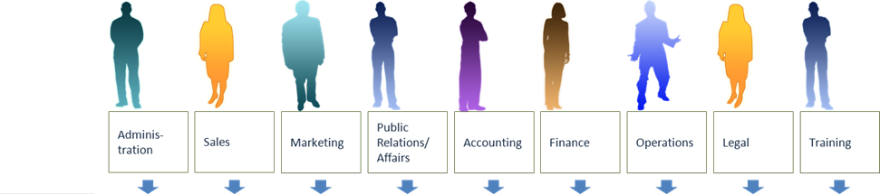
MOS Mapping to Key Job Roles by Application
Specialist Word Excel PowerPoint Outlook Access SharePoint
Expert Word Excel
*Master
*Master Cert requires Word Expert, Excel Expert, PowerPoint, and either Outlook or Access
Notes:
Did you know? Almost every field touches upon the knowledge of Microsoft Office applications.

Slide 8

Sample Certificate

Slide 9
MOS Certification
Microsoft Office Specialist (Office 2016)

Slide 10
MOS 2016 Certificate
MOS Specialist
To earn MOS Specialist Certification pass one of the following exam:
MOS Expert
To earn MOS Expert Certification pass one of the following tracks:
MOS Master
To earn MOS Master Certification complete three require exams and one elective exam:
Require three exams:
One elective exam:
77-726: Word Expert 2016
77-728: Excel Expert 2016
77-729: PowerPoint 2016
77-730: Access 2016
77-726: Word Expert 2016
77-728: Excel Expert 2016
77-725: Word 2016
77-727: Excel 2016
77-729: PowerPoint 2016
77-730: Access 2016
77-731: Outlook 2016
77-731: Outlook 2016

Slide 11
Exams lengths
Code | Exam | Questions | Minutes | Note
77-725 | Word | 35 | 50
77-727 | Excel | 35
77-729 | PowerPoint | 35
77-730 | Access | 31
77-726 | Word Expert | 26
77-728 | Excel Expert | 26
77-731 | Outlook | 35

Slide 12
MOS Certification
Microsoft Office Specialist (Office 2019)

Slide 13
MOS 2019 Certificate
MOS Associate
To earn the Microsoft Office Specialist: Association certification, pass three of the following exams:
MOS Expert
To earn a Microsoft Office Specialist: Expert Certification, complete the following requirements:
Earn a Microsoft Office Specialist Associate certification.
MO-100: Microsoft Word (Office 2019)
MO-300: Microsoft PowerPoint (Office 2019)
MO-200: Microsoft Excel (Office 2019)
MO-400: Microsoft Outlook (Office 2019)
Pass any two of the following three Expert exams:
MO-101: Microsoft Word Expert (Office 2019)
MO-201: Microsoft Excel Expert (Office 2019)
MO-500: Microsoft Access Expert (Office 2019)

Slide 14
Exams lengths
Code | Exam | Questions | Minutes
MO-100 | Word | 35 | 50
MO-200 | Excel | 35
MO-300 | PowerPoint | 35
MO-400 | Outlook | 35
MO-101 | Word Expert | 25
MO-201 | Excel Expert | 25
MO-500 | Access Expert | 31

